Slide 1
Upstream
PART 5: Further information

Slide 2
1 – RESOURCES FOR CHILDREN
Using some of these books and resources can help you start some really important conversations with your children.
However, before you read them with your child read them through yourself first, so that you can judge if the information is appropriate for your child and so you are familiar with the story.
Finally, see these stories as a springboard to further conversation, discussion and continued teaching and learning.

Slide 3
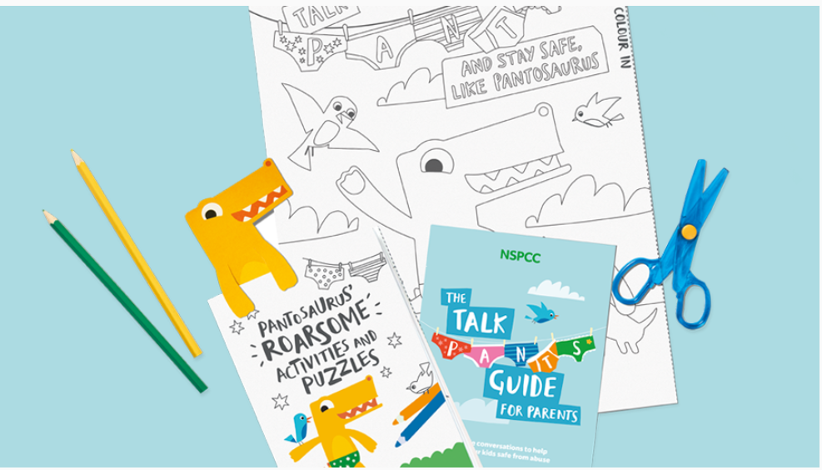
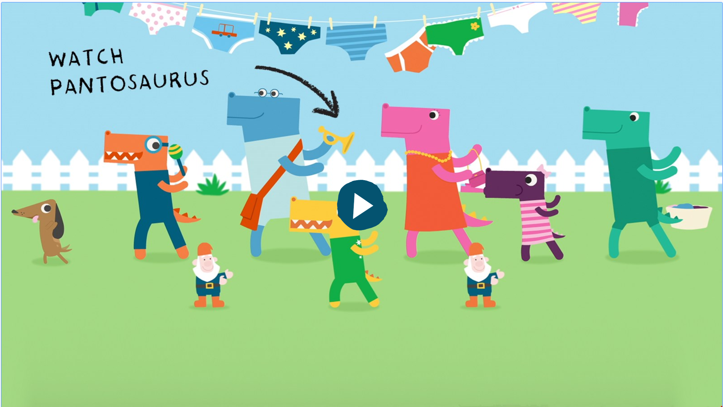
1 – RESOURCES FOR YOUNG CHILDREN
Websites
NSPCC PANTS Campaign
Ages 5-11
https://www.nspcc.org.uk/preventing-abuse/keeping-children-safe/underwear-rule/
With the help of our friendly dinosaur Pantosaurus, talking PANTS is a simple way to teach your child how to stay safe from abuse.
Talking PANTS is as simple as teaching your child how to cross the road. You know your child better than anyone. You'll know when they're ready and how much detail to use.
You can use moments such as bathtime, getting your child dressed, car journeys or going swimming to start talking PANTS. Or you can use one of these online resources:
Sing along with Pantosaurus - Our singing dinosaur video is a great way to introduce PANTS to your child.
PANTS activity pack - With fun tasks, word searches, games and stickers, you can help them learn without using any scary words.
Download the PANTS game - In the Playtime with Pantosaurus game, each of the principles of PANTS is introduced in between fun diving and basketball games.

Slide 4
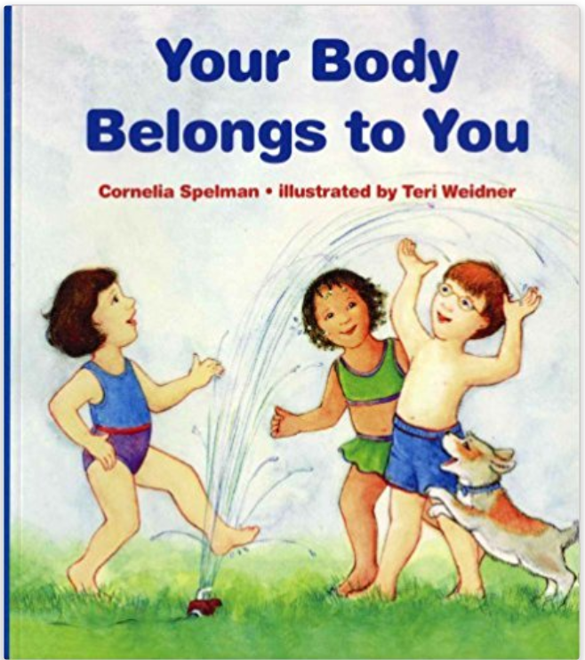
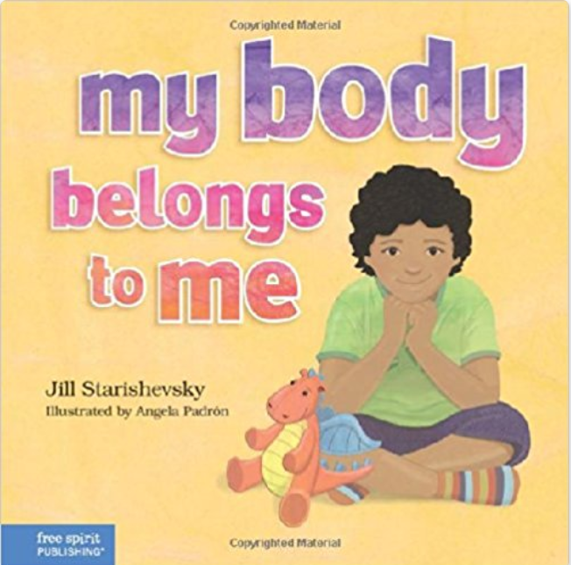
1 – RESOURCES FOR CHILDREN
Picture Books
Your Body Belongs to You – 1 Jan 1997
Ages 3-6
by Cornelia Maude Spelman (Author),‎ Teri Weidner (Illustrator)
This sensitive book explains to children that they have a right to their own bodies, and they can choose when and by whom they can be touched. Also gives descriptions about private parts and other details. Full-color illustrations.
My Body Belongs to Me: A Book about Body Safety Hardcover – 1 May 2014
Ages 3-10
by Jill Starishevsky
Without being taught about body boundaries, a child may be too young to understand when abuse is happening or that it's wrong. This straightforward, gentle book offers a tool parents, teachers, and counselors can use to help children feel, be and stay safe. The rhyming story and simple, friendly illustrations provide a way to sensitively share and discuss the topic, guiding young children to understand that their private parts belong to them alone.

Slide 5
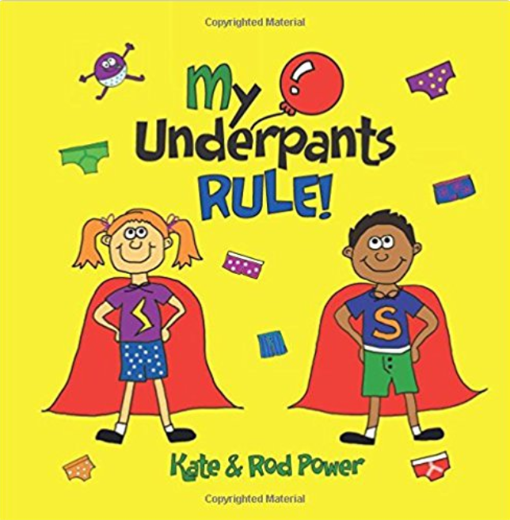
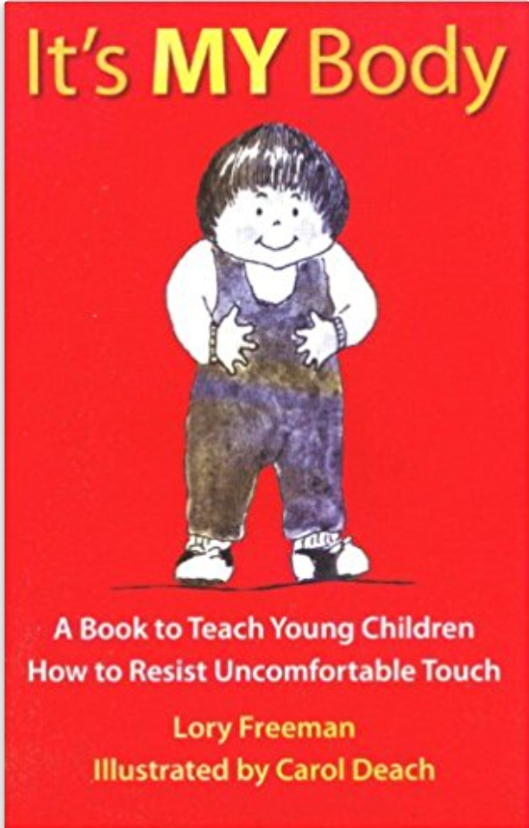
1 – RESOURCES FOR CHILDREN
Picture Books
My Underpants Rule Paperback – Large Print, 10 Jun 2014
Ages 3-8
by Rod Power (Author),‎ Kate Power (Creator)
Teaching kids to protect themselves is child's play! This book empowers without needing to go into the darkness of this tricky topic through rhyming language, colourful illustrations, a super-hero theme and child-friendly humour. Loved by kids and easy for parents/carers and educators, it engages and effectively teaches "What's under my PANTS belongs ONLY to ME!". Reinforced by games and scenarios, it clearly defines what is appropriate and inappropriate, and ingrains what to do should anything happen.
It's MY Body: A Book to Teach Young Children How to Resist Uncomfortable Touch (Children's Safety Series and Abuse Prevention) Paperback – 1 Jan 1982
Ages 3-5
by Lory Freeman (Author)
Preschool children can learn safe boundaries, how to distinguish between "good" and "bad" touches, and how to respond appropriately to unwanted touches. This is a powerful book for enhancing self-esteem. Parenting Press's bestseller!

Slide 6
1 – RESOURCES FOR CHILDREN
Picture Books
No Means No!: Teaching personal boundaries, consent; empowering children by respecting their choices and right to say 'no!’
Ages 3-9
by Jayneen Sanders (Author),‎ Cherie Zamazing (Illustrator)
'No Means No!' is a children's picture book about an empowered little girl who has a very strong and clear voice in all issues, especially those relating to her body and personal boundaries. It is a springboard for discussions regarding children's choices and their rights. The 'Note to the Reader' at the beginning of the book and the 'Discussion Questions' on the final pages, guide and enhance this essential discussion. It is crucial that our children, from a very young age, are taught to have a clear, strong voice in regards to their rights - especially about their bodies. In this way, they will have the confidence to speak up when they are unhappy or feel uncomfortable in any situation.

Slide 7
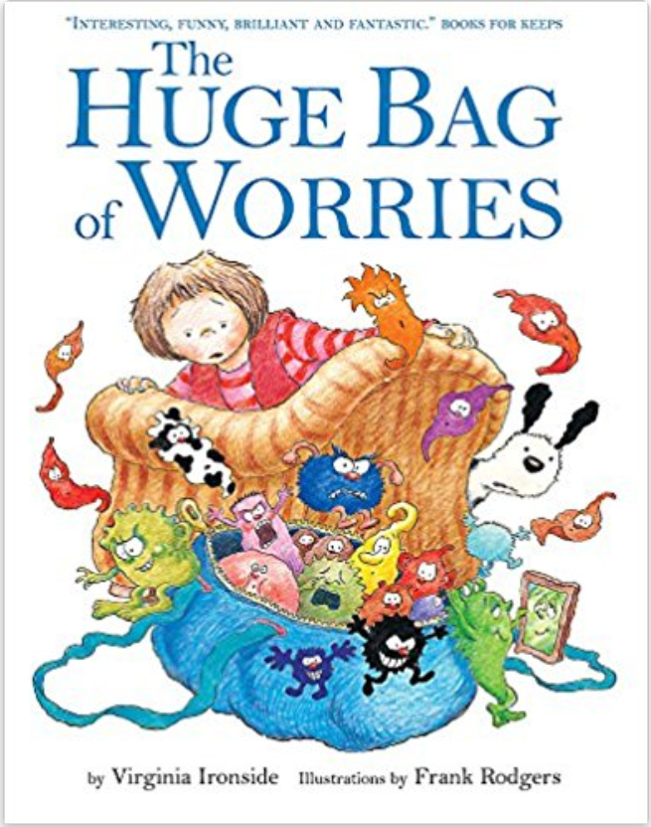
1 – RESOURCES FOR CHILDREN
Picture Books
The Huge Bag of Worries Paperback – 6 Jan 2011
Ages 5-10
by Virginia Ironside (Author),‎ Frank Rodgers (Illustrator)
Wherever Jenny goes, her worries follow her - in a big blue bag. They are there when she goes swimming, when she is watching TV, and even when she is in the lavatory. Jenny decides they will have to go. But who can help her?
The Huge Bag of Worries was written by Virginia Ironside, one of Britain's leading agony aunts, and has sold 140k copies to date.
'This book can be read millions of times when you are worried.' - Books for Keeps A compelling picture book which can be used as a spring board into what worries children today.

Slide 8
1 – RESOURCES FOR CHILDREN
Picture Books
Some Secrets Should Never Be Kept: Protect children from unsafe touch by teaching them to always speak up Paperback – 11 Jan 2011
Ages 3-12 by Jayneen Sanders (Author),‎ Craig Smith (Illustrator)
This beautifully illustrated children's picture book sensitively broaches the subject of keeping children safe from inappropriate touch. We teach water and road safety, but how do we teach Body Safety to young children in a way that is neither frightening nor confronting? This book is an invaluable tool for parents, caregivers, teachers and healthcare professionals to broach the subject of safe and unsafe touch in a non-threatening and age-appropriate way. Comprehensive notes to the reader and discussion questions at the back of the book support both the reader and the child when discussing the story.

Slide 9
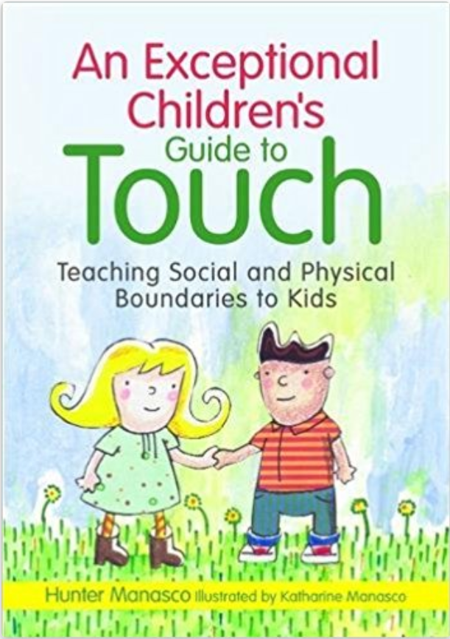
1 – RESOURCES FOR CHILDREN
Picture Books
An Exceptional Children's Guide to Touch: Teaching Social and Physical Boundaries to Kids Hardcover – 15 Aug 2012
by McKinley Hunter Manasco (Author),‎ Katharine Manasco (Illustrator)
The rules of physical contact can be tricky to grasp and children with special needs are at a heightened risk of abuse. This friendly picture book explains in simple terms how to tell the difference between acceptable and inappropriate touch, thereby helping the child with special needs stay safe.
Each story covers a different type of touch from accidental to friendly to hurtful and will help children understand how boundaries change depending on the context. It explores when and where it is okay to touch other people, when and where other people can touch you, why self touching sometimes needs to be private, and what to do if touch feels inappropriate.
This book is an invaluable teaching resource and discussion starter for parents, teachers and carers working with children with special needs.

Slide 10
2 – RESOURCES FOR ADOLESCENTS
Books
Let's Talk About Sex Paperback – Special Edition, 4 Sep 2014
Preteen and teenagers
by Robie H. Harris (Author),‎ Michael Emberley (Illustrator)
A completely updated 20th anniversary edition of the definitive book on childrens’ sexual health.
Now with expanded information on internet and texting safety, birth control, LGBT (gay, lesbian, bisexual, transgender) issues and more – this universally acclaimed classic by Robie H. Harris and Michael Emberley is a cutting-edge resource for children, parents, teachers, librarians and anyone else who cares about the well-being of pre-teens and teens. Providing accurate and up-to-date information to answer young people's concerns and questions, from conception and puberty to birth control and AIDS, it offers everything they need – now more than ever – to make responsible decisions and stay healthy.

Slide 11
2 – RESOURCES FOR ADOLESCENTS
Books
S.E.X.: The All-You-Need-To-Know Sexuality Guide to Get You Through Your Teens and Twenties
Ages 14+
by Heather Corinna
As a teen or emerging adult, dealing with all the changes going on in your life, body, and mind can be mighty overwhelming. When it comes to sex, everyone seems to have strong feelings and opinions about who you should be and what you should (shouldn't) do. How do you decide who to listen to?
S.E.X tackles all the big topics:
Self-image and how to find and claim your own sexual self
How to best protect and support your sexual and emotional health
Sorting out gender and sexual identities, even when they're complicated and confusing
The latest on contraceptive methods and other reproductive choices, sexually transmitted infections, and safer sex
Finding, creating, and managing healthy and happy relationships
How to set and respect limits and boundaries, and rock consent
Identifying, preventing, or healing from abuse or assault...and much more

Slide 12
2 – RESOURCES FOR ADOLESCENTS
Websites
Scarleteen
Ages 14+
www.scarleteen.com
This sex-ed website for teens and young adults covers a range of topics relating sexual and emotional health, sex and relationships.
In relation to abuse, it also regularly features articles and letters on the topic of sexual and domestic violence and abuse, specifically tailored for teenage relationships.
It also has a clear and comprehensive guide to consent (‘Driver’s Ed for the Sexual Superhighway’), to help your teen navigate this tricky area, and keep themselves and others safe from harm.

Slide 13
2 – RESOURCES FOR ADOLESCENTS
Websites
That’s Not Cool
Ages 13+
www.thatsnotcool.com
This website has been created to help young people and their parents understand how mobile phones, instant messaging and online profiles are all digital extensions of who we are. It aims to give the tools to help people think about what is, or is not, okay in their digital relationships.
They also embrace ‘gamification’, with apps such as Respect Effect (focused on building respect in friendships and relationships) and Cool / Not Cool (a quiz game)

Slide 14
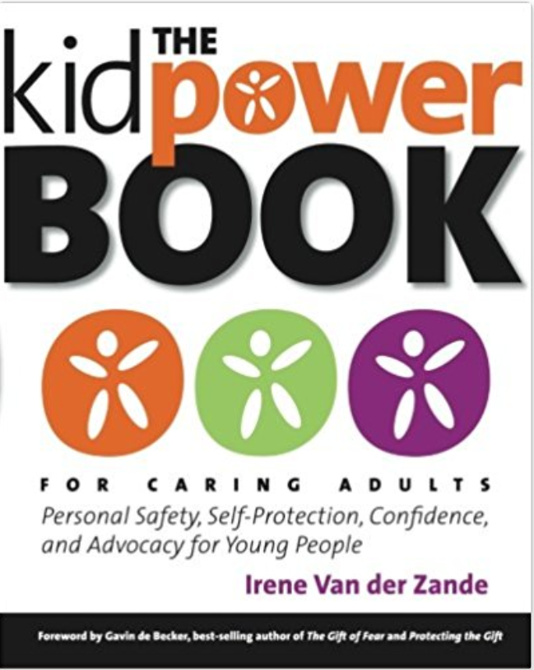
3 – RESOURCES FOR PARENTS
Books
The Kidpower Book for Caring Adults: Personal Safety, Self-Protection, Confidence, and Advocacy for Young People
Ages 3+
by Irene Van der Zande
This comprehensive guide prepares parents, educators, and other caring adults to protect children and teens from bullying, violence, and abuse through awareness, action, and skills. Kidpower's positive hands-on method reduces anxiety, develops competence, and increases confidence for adults and children alike. Topics include: building a foundation of emotional safety; self-protection to stop most trouble before it starts; and healthy boundaries to prevent problems and develop positive relationships. The Kidpower Book for Caring Adults is the most comprehensive guide available for adults who want to learn how to protect and promote the emotional and physical safety of the young people in their lives. Through inspiring stories, clear explanations, and step-by-step practices, readers gain extensive knowledge from Kidpower's 25+ years of experience of teaching "People Safety" skills to over 2.5 million children, teens, and adults worldwide. These social-emotional skills help prepare adults to protect and empower the young people in their lives.

Slide 15
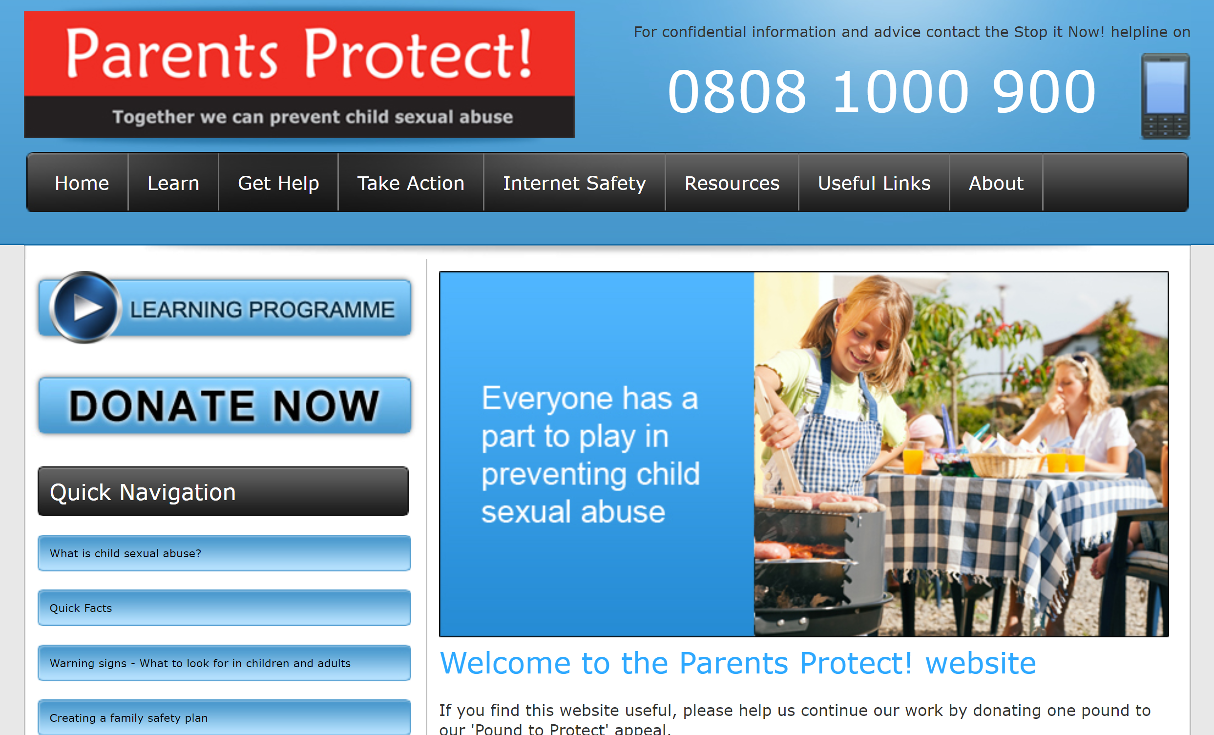
3 – RESOURCES FOR PARENTS
Websites
Parents Protect
Ages 3+
www.parentsprotect.co.uk
This information and resources website is run by the Lucy Faithfull Foundation. It aims to raise awareness about child sexual abuse, answer questions and give adults the information, advice, support and facts, they need to help protect children.
Their aim is to help parents and carers better protect children from sexual abuse. Our most important task is to prevent sexual abuse from taking place in the first place.
The Resources section of the website contains a number of guides that expand on the information in this training course – including topics such as building a family safety plan, normal sexual development of children, and internet safety

Slide 16
3 – RESOURCES FOR PARENTS
Websites
Kidpower
Ages 3+
www.kidpower.org
Kidpower is a global non-profit dedicated to providing empowering and effective child protection, positive communication, and personal safety skills for all ages and abilities.
They have an extensive and free online library and affordable publications covering topics such as bullying, sexual abuse, abduction and other violence.
There is a section specifically dedicated to sexual abuse, with articles frequently published on the topic.

Slide 17
3 – RESOURCES FOR PARENTS
Websites
Think U Know
Ages 5+
www.thinkuknow.co.uk
Thinkuknow is a unique education programme underpinned by the latest intelligence about child sex offending from the National Crime Agency.
It aims to ensure that everyone has access to this practical information – children, young people, their parents and carers and the professionals who work with them. There are several different websites designed to appeal to each group.
The site covers topics such as online grooming, online porn and sharing information online.

Slide 18
4 – FURTHER RESOURCES
CHILDLINE |  | 0800 1111
MOSAC | Offers guidance & counselling to non-abusing parents & carers whose children have been sexually abused. | 0800 9801958
FAMILY LIVES | Provides help and support in all aspects of family life. Open 24 hours | 0808 8002222
YOUNG MINDS PARENT HELPLINE | For any adult worried about the emotional problems, behaviour or mental health of a child or young person up to age 25. Mon to Fri 9.30-4.00pm | 0808 8025544
SAMARITANS | Samaritans offer confidential help giving you time to talk things over | 0845 7909090
INTERNET WATCH FOUNDATION (IWF) | Report criminal online content: Child sexual abuse content hosted worldwide Obscene adult content hosted in the UK Non-photographic child sexual abuse images hosted in the UK | 01223 237700 www.iwf.org.uk
CRIMESTOPPERS | Report crimes anonymously. | 0800 555111
GET - HELP | Anonymous online self-help resource for people accessing Indecent images of children. | www.get-help.stopitnow.org
GET-SUPPORT | Anonymous online self-help resource for people who have inappropriate sexual thoughts about children. | www.get-support.stopitnow.org.uk
NAPAC | National Association for People Abused in Childhood. 10-9.00pm Mon to Thurs, 10-6.00pm Friday | 0808 801 0331
SURVIVORS UK | Provides information, support & counselling for MEN who have been raped or sexually abused. 7-9.30pm Mon and Tues | 0845 1221201
STEP UP | Helpline providing support for parents/carers of sexually abused children. 7.30-9.30pm Wed and Tues | 020 8517 5888

Slide 19
4 – FURTHER RESOURCES
RAPE & SEXUAL ABUSE SUPPORT CENTRE | Is a voluntary UK charitable organisation providing a National Rape Crisis Line for women who have survived sexual violence at any point in their life. (www.rasasc.org.uk) 12-14.30&19.00-21.30 Daily | 0808 802 9999
BRITISH ASSOCIATION FOR COUNSELLING & PSYCHOTHERAPY | Provides list of counsellors and psychotherapist and Professional bodies offering therapy | www.bacp.co.uk 0870 443 5252
ONE IN FOUR UK | Offers support for people who have experienced sexual Abuse &/or sexual violence, through individual therapy And helpline support | 0208 697 2112
ONE IN FOUR IRELAND | As above | 01662 4070
CORAM CHILDREN’S LEGAL CENTRE | Coram Children’s Legal Centre, part of the Coram group of charities, specialises in law and policy affecting children and young people. CCLC provides free legal information, advice and representation to children, young people, their families, carers and professionals, as well as international consultancy on child law and children’s rights. For more information on Coram, please visit their website. Child Law Advice Line: 0808 802 0008 | www.childrenslegalcentre.com

